Slide 1
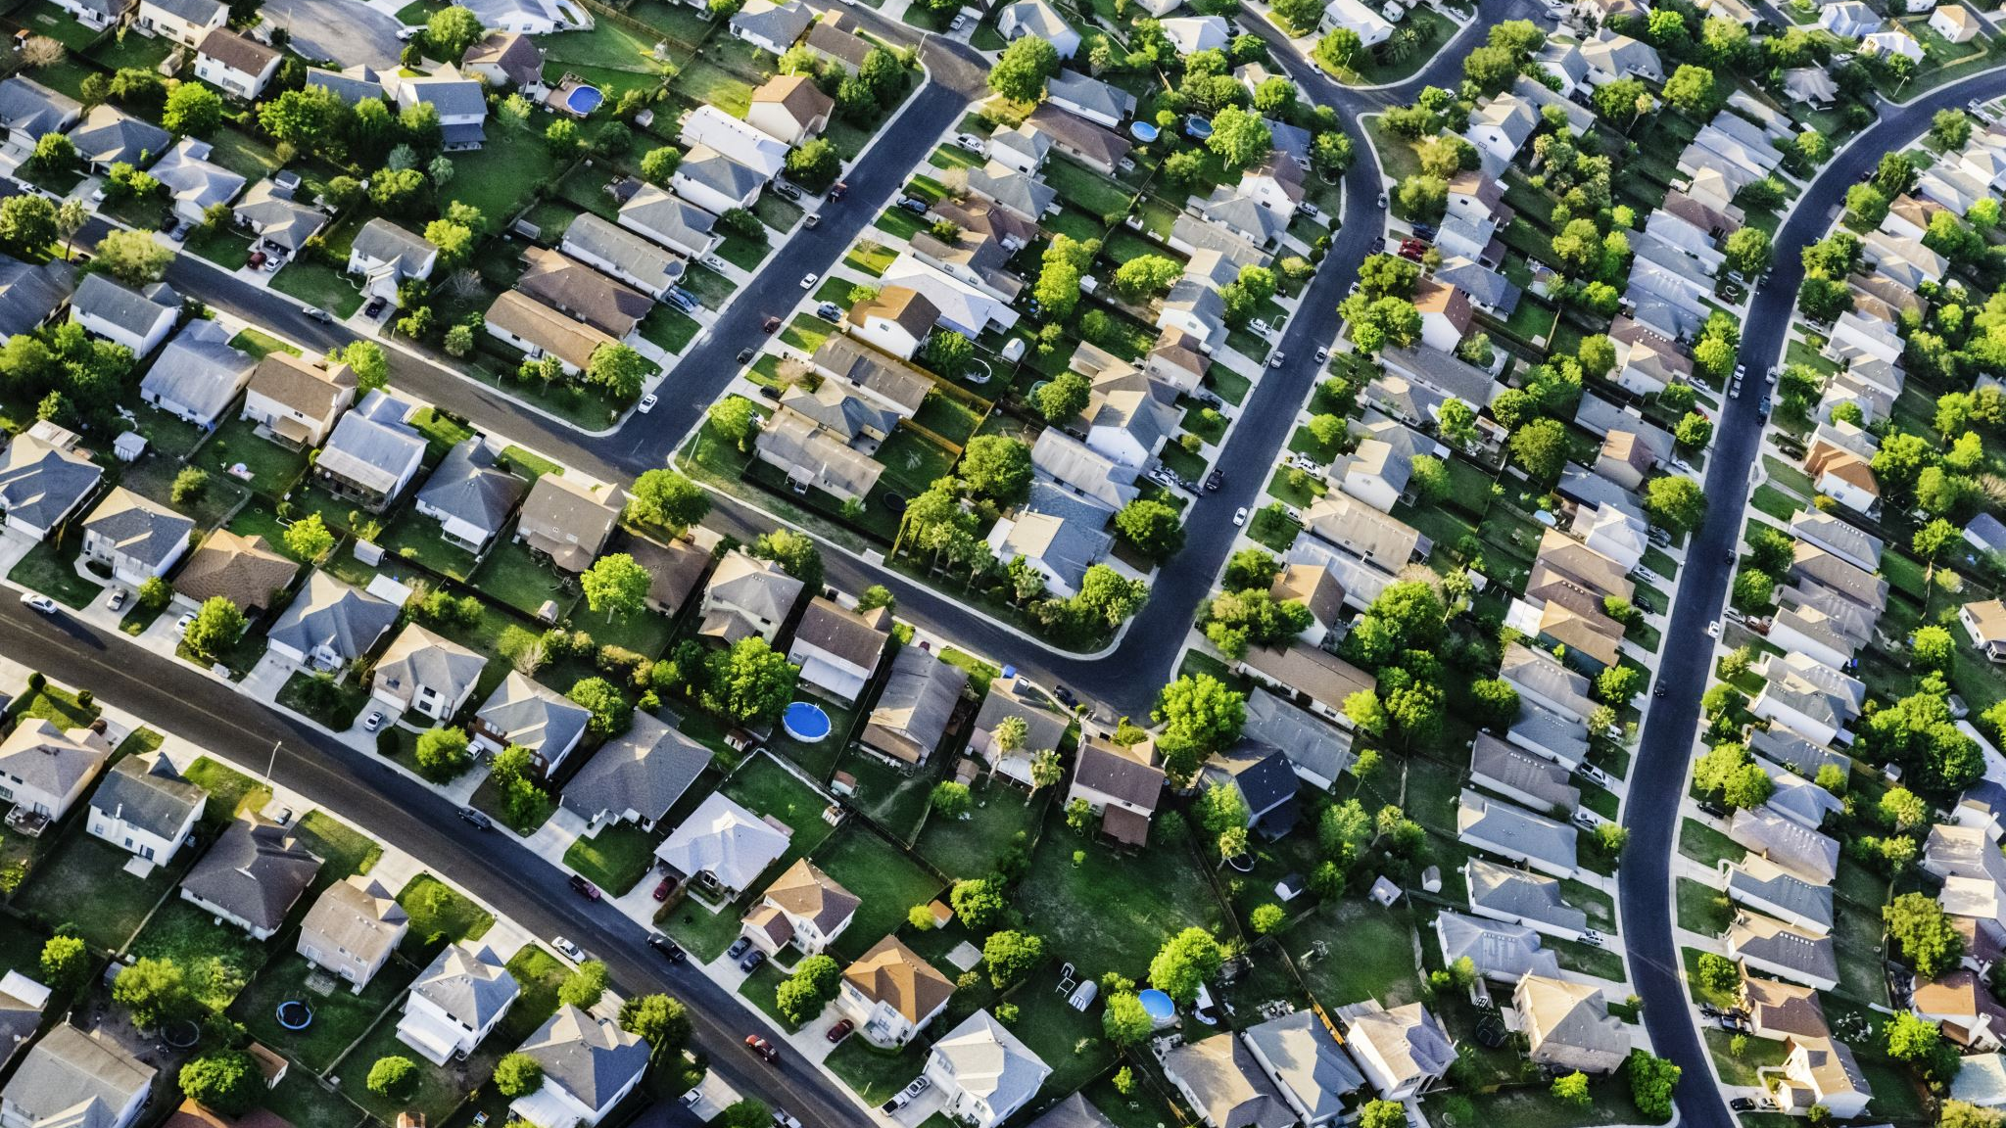

Guidelines for legal Evictions
Presented by the law firm of Pattison, Sampson, Ginsberg & Griffin, PLLC

Slide 2

Introduction
Pattison, Sampson, Ginsberg & Griffin, PLLC. (518) 266-1000
Rhiannon I. Gifford, Esq. (gifford@psgglaw.com)
Partner
200+ Years Of Legal Service
The Firm Of Pattison, Sampson, Ginsberg & Griffin, PLLC, Traces Its Roots To The Early 1800'S. Located In Troy, New York, The Firm's Practice Is Extensive Throughout The Capital Region And Elsewhere In New York State.

Slide 3

Notices for non-payment of rent
The tenant is entitled to a five-day grace period to pay rent before a late fee can be charged.
If rent is due on the 1st of the month, a late fee can be charged on the 6th of the month.
In order to commence a summary proceeding based upon non-payment of rent, the landlord must send two different notices to the tenant. RPL §235-E and RPAPL 711(2).

Slide 4
RPL § 235-E notice
This notice must state that the landlord has not received rent within five days of the date specified in the lease.
  Example: If rent is due on the 1st of the month, notice may be sent on the 6th day of the month.
Must be sent by certified mail .
Suggested to send by regular mail as well.

Slide 5
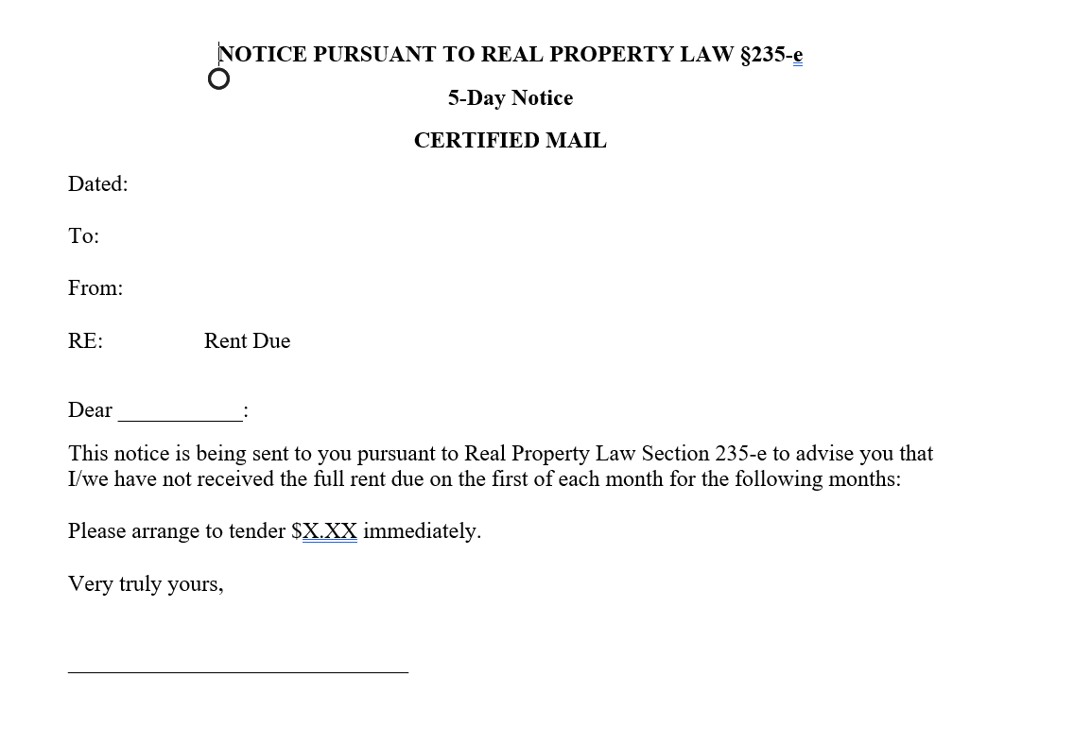
RPL § 235-E notice

Slide 6
RPAPL 711(2) Notice
This notice is commonly referred to as the “written demand for payment of rent.”
Notice must provide the tenant with 14 or 30 days requiring, in the alternative, the payment of the outstanding rent, or that the tenant vacate the premises.
New HUD regulation effective January 13, 2025
  Section 8 Project-Based Rental Assistance (PBRA)
  Public Housing Units
  Supportive housing for elderly and disabled persons
  NOT Housing Choice Voucher (HCV) program
  NOT Project-Based Voucher (PBV program)
  NOT Rental Assistance Demonstration (RAD) program
CARES Act “covered dwellings” must still provide 30 days
If you are a PHA you must incorporate 30 day notice in the lease or by addendum no later than July 16, 2026
HUD will release a model lease for PBRA- must use within 14 months of release

Slide 7
30 day notice requirements
An itemized breakdown, by month, of the alleged amount owed by the tenant, along with any other arrearages allowed by HUD and included in the lease;
The date by which the household must pay before a formal eviction is filed;
Instructions on how the household can cure nonpayment;
Information on how the household can recertify their income, request a minimum rent hardship exemption, and (if applicable), switch from flat rent to income-based rent

Slide 8
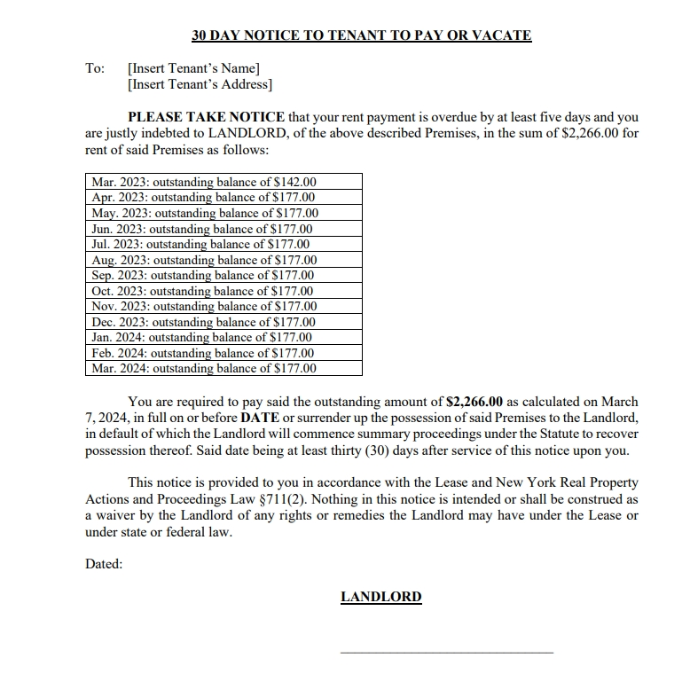
RPAPL 711(2) Notice

Slide 9

Violations of the lease agreement
If the tenant is in violation of any provision (or rules) of the lease agreement, the tenant must be granted 10 days to cure the defect, or the lease will be terminated.
The notice to cure must be sufficiently detailed and should identify the provision of the lease agreement that the complained of defect violates. (Remember, eviction proceedings can only be based upon the basis set forth in the notices)
The notice must set forth definitive and unequivocal terms that the tenant is required to do or refrain from doing to cure the defect.
The notice should state a date upon which inspection will occur.
If the tenant fails to remedy the defect by the date of the inspection, the landlord must serve a notice of termination which clearly identifies the basis for the lease termination.
  Notice of termination based upon length of tenancy
  Date of vacatur must coincide with the end of a term. Example: At the end of the month for a lease that begins on the 1st.
The landlord cannot accept rent after the notice of termination expires or a new term begins.
Notes:
Occupancy < 1 year OR lease term ≤ 1 year → 30 days’ notice
Occupancy > 1 year but ≤ 2 years OR lease term ≥ 1 year but < 2 years → 60 days’ notice
Occupancy > 2 years OR lease term ≥ 2 years → 90 days’ notice

Slide 10
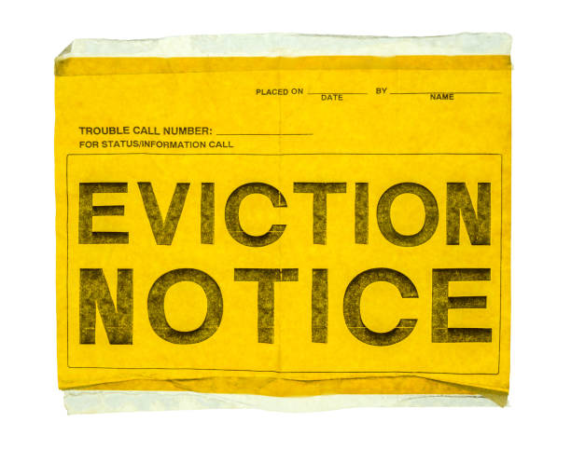
Commencing an eviction proceeding
Notice of Petition and Petition
Notice of Petition
  Contains the caption of the matter, aka Landlord v. Tenant.
  Set forth the location of where the proceeding will take place, the date and time of the proceeding, and what remedy the landlord is seeking.
  The date for the proceeding is set by the clerk of the court.

Slide 11
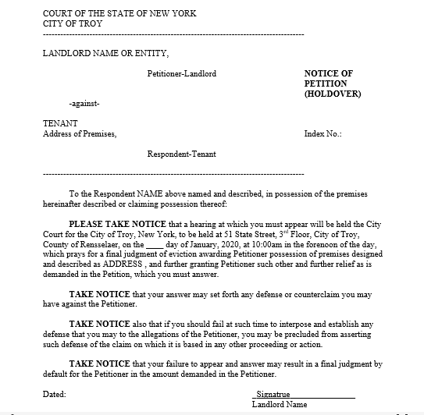
Notice of petition

Slide 12
Petition
Sets forth the facts of the matter and attaches relevant exhibits.
Exhibits typically include:
  The lease agreement.
  A copy of the notices sent to the tenant and an affidavit of service attesting to the service.

Slide 13
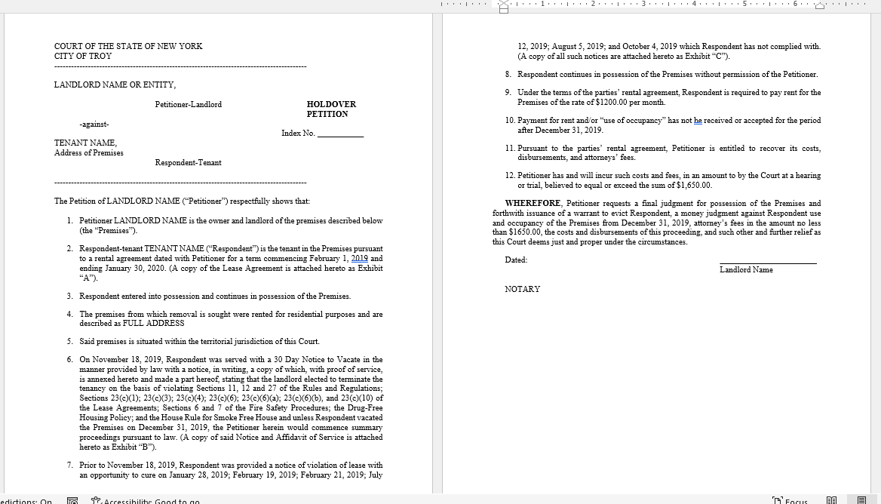
Petition

Slide 14
Other required court documents/
Notices
Notice of Court Date: Eviction Case (USC-LTH1) or
Notice of Court Date: Rent Not Paid (USC-LTN1)
Eviction Petition- Holdover (USC-LTH2) or
Eviction Petition-Rent Not Paid (USC-LTN2)
Notice to Tenant of Applicability of Inapplicability of the New York State Good Cause Eviction Law (RPL 231-C)
HUD VAWA Notice of Occupancy Rights Under the Violence Against Women Act

Slide 15

When you must use a process server/ disinterested third party
MUST | Not Required
Non-payment notice | 5-day notice by certified mail
Early termination notice for breach | 10 day notice to cure
Petition | Non-renewal notice

Slide 16

Questions
Contact Information
Rhiannon I. Gifford, Esq.
Gifford@psgglaw.com
(518) 266-1001

